Slide 1
LIBRARY MANAGEMENT SYSTEM
PRESENTED BY: GROUP 4
MEMBERS:
ALIMOCON, LIZA MAE
GUANZON, MARK
OLAGUIR, JOHN EISLEY
TORILLO, BABYLINCHE
TOYONG, MIKE MELVEN

Slide 2
INTRODUCTION
In today’s digital age, libraries serve as vital hubs for knowledge dissemination, requiring efficient tools to manage vast collections of resources. A Library Management System (LMS) is a software solution designed to automate and streamline library operations, from cataloging books to tracking user interactions. This system addresses common challenges such as manual record- keeping errors, inefficient search processes, and poor inventory control, ultimately enhancing user experience and operational productivity.

Slide 3
STATEMENT OF THE PROBLEM
In many libraries, managing the vast collection of books, membership, and transactions manually often leads to inefficiencies, errors, and delays. The manual processes make it difficult to keep accurate records, track borrowed and returned books, manage member information, and generate reports promptly. This can result in issues such as lost books, overdue items, and difficulty in inventory management.
Therefore, there is a need for an automated Library Management System that can efficiently handle the operations of adding, updating, and deleting book and member records, as well as managing borrowing and returning transactions. An automated system aims to streamline library activities, improve accuracy, reduce manual effort, and enhance user experience.

Slide 4
OBJECTIVE OF THE STUDY
To provide an easy-to-use interface for managing books and members records.
To automate the process of borrowing and returning books.
To generate real-time reports on inventory and borrowing history.
To improve the overall efficiency and accuracy of library operations.
Register and manage library members.
Facilitate borrowing and returning of books.

Slide 5
SCOPE OF THE LIMITATION
Manage book inventory including adding, updating, and deleting book records.
Tracks member registrations and manages their profiles.
Handles book lending and returns, tracking due dates and fines.
Provides search functionality for books by title, author, or category.
Generates reports on book availability, borrowing history, and overdue books.
Supports multiple user roles such as (librarian, member) with different access levels.

Slide 6
LIMITATION OF THE STUDY
Does not support integration with external databases or other library systems.
Limited to managing physical books only; does not support e-book or digital materials.
The system may not handle offline operations; requires constant internet connection if web-based.
Does not include advanced recommendation features based on user borrowing history.
Limited scalability; may not support large libraries with thousands of records efficiently.
May lack automated notifications for due dates and overdue books unless integrated with an email/SMS system.

Slide 7
SYSTEM REQUIREMENTS
Hardware Requirements
Processor: Minimum 2 GHz dual-core processor or higher
RAM: At least 4 GB (8 GB recommended for better performance)
Storage: Minimum 500 MB free disk space for installation, plus extra for database storage
Display: Monitor with at least 1024x768 resolution
Input Devices: Keyboard and mouse

Slide 8
Software Requirements
Operating System: Windows 10 or higher, Linux, or macOS
Database Management System: MySQL, PostgreSQL, or any supported RDBMS
Runtime Environment: Java Runtime Environment (JRE) if built with Java, or NET Framework if build with NET.
Web Server (if web-based): Apache, Nginx, or IIS
Browser (if web-based): Latest versions od Chrome, Firefox, Edge, or Safari

Slide 9
Network Requirements
Stable internet connection for online access and multi-user environment.
Local Area Network (LAN) support for internal network usage in libraries.

Slide 10
User Requirements
Different access levels foe libraries, members, and administrators.
Use authentication via username and password.

Slide 11
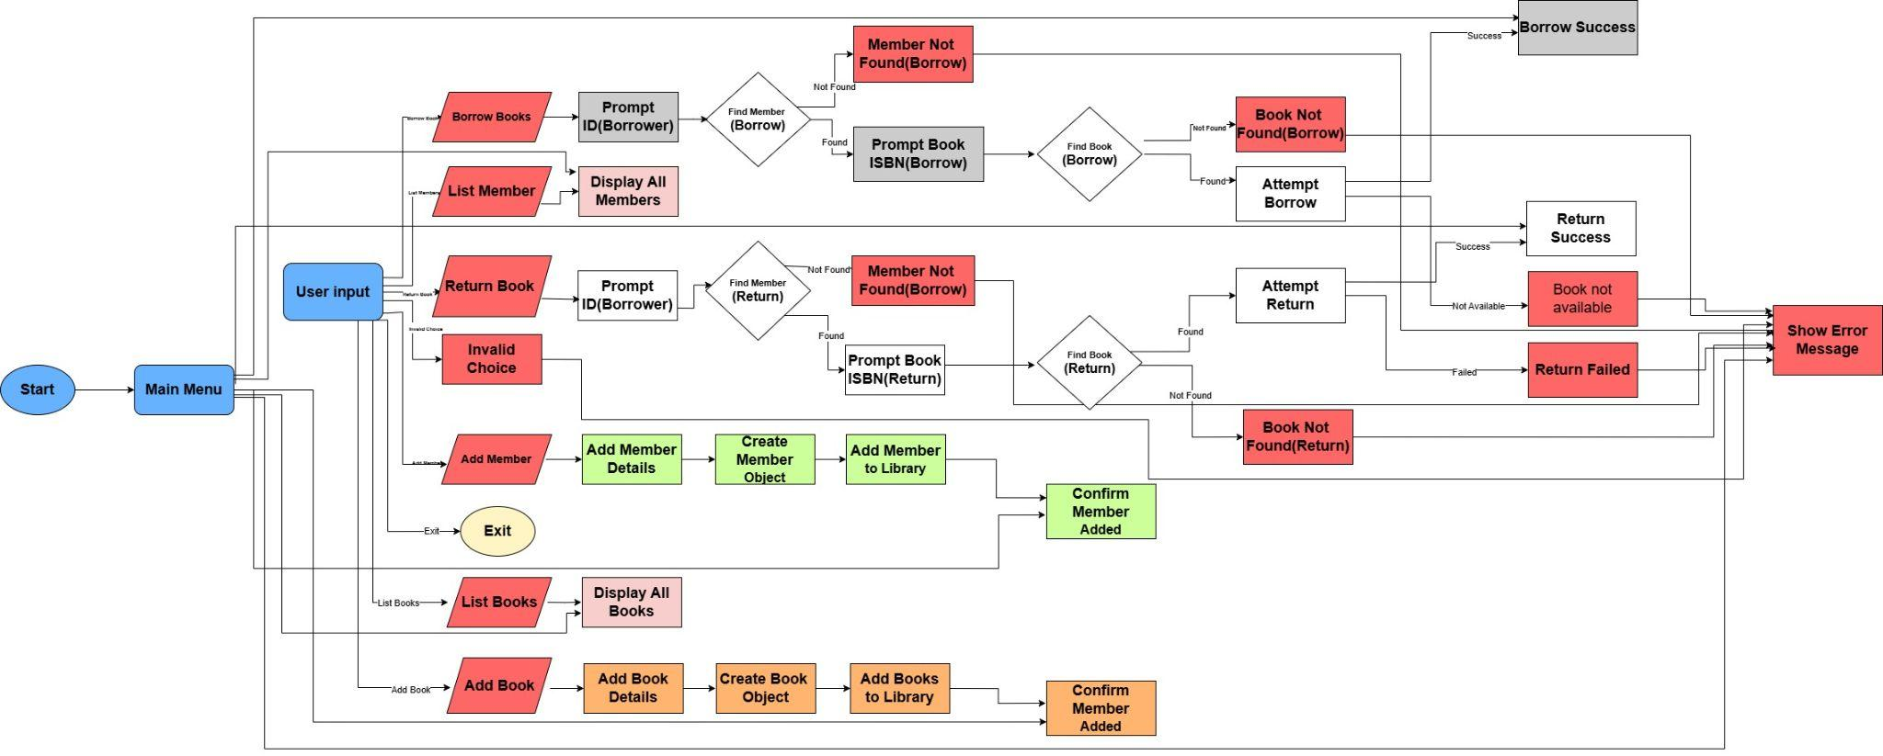
FLOWCHART

